Slide 1
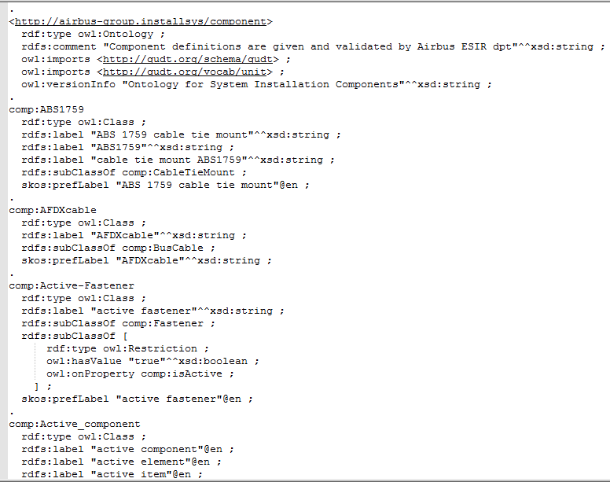
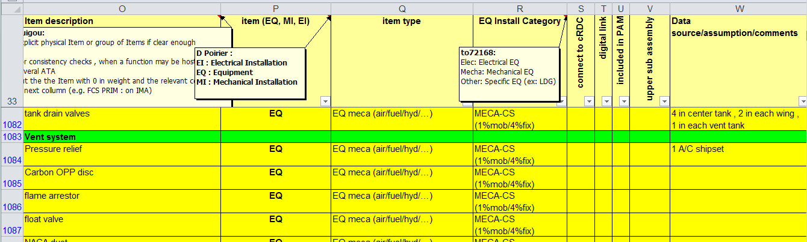
Ex. BOM, Component taxonomy, Component ontology
DRAFT

Slide 2
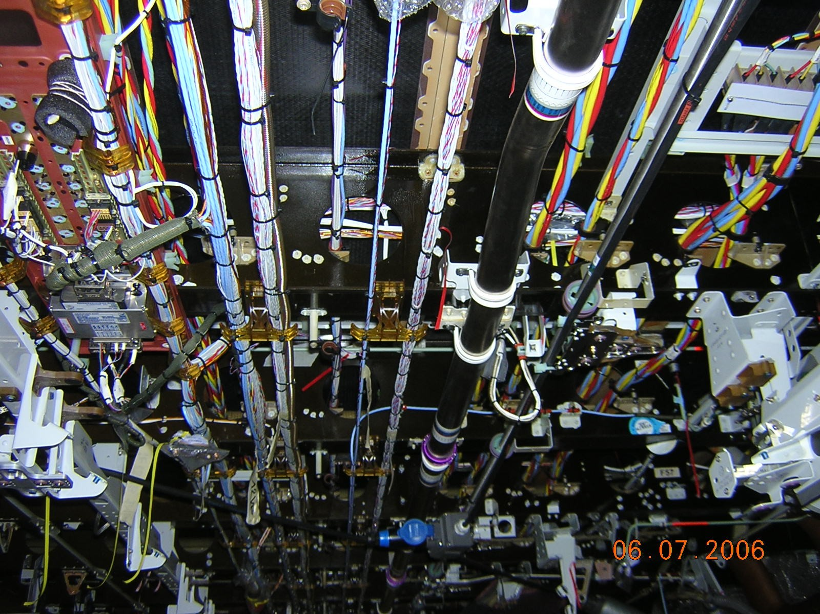
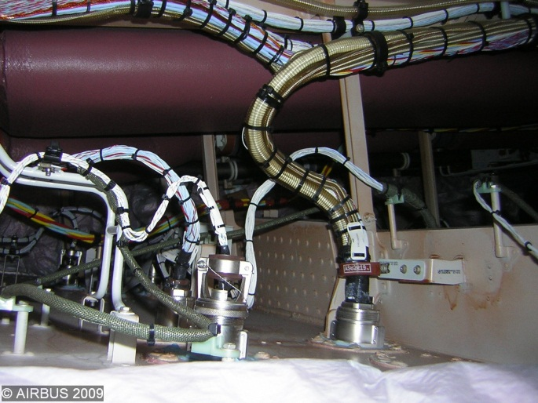
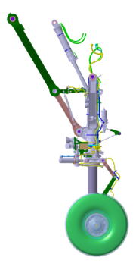
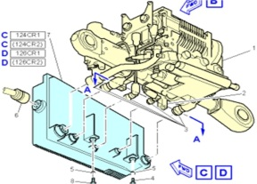
Electrical wiring interconnection system (EWIS)
DRAFT
Mainly: Aircraft electrical common installation (ATA92)
1
3
11
12
6
8
4, 5
10
13
But also: part of Systems equipment wiring:
Power distribution centers wiring
External wiring of equipment
Wiring of equipment not qualified to appropriate standards e.g. EUROCAE ED-14 / RTCA DO-160
cf CS 25.1701(b)&(c)

Slide 3
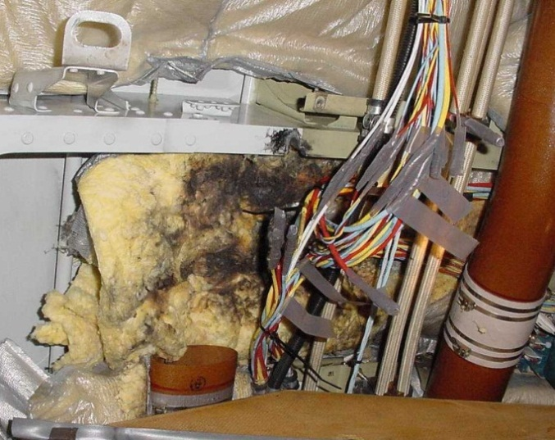
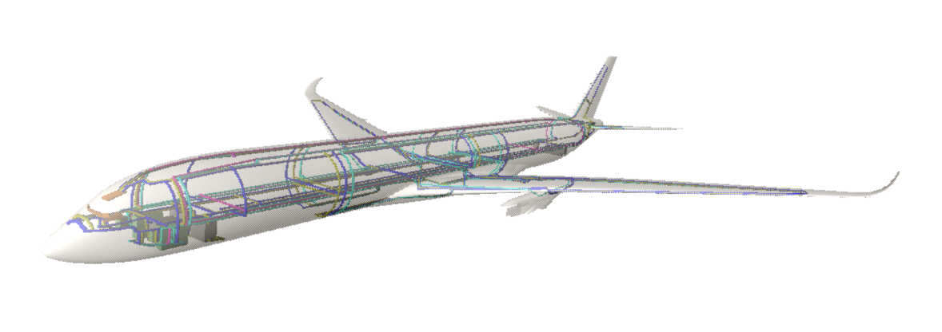
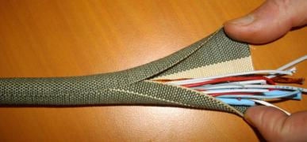
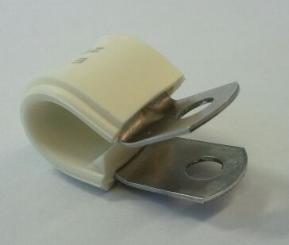
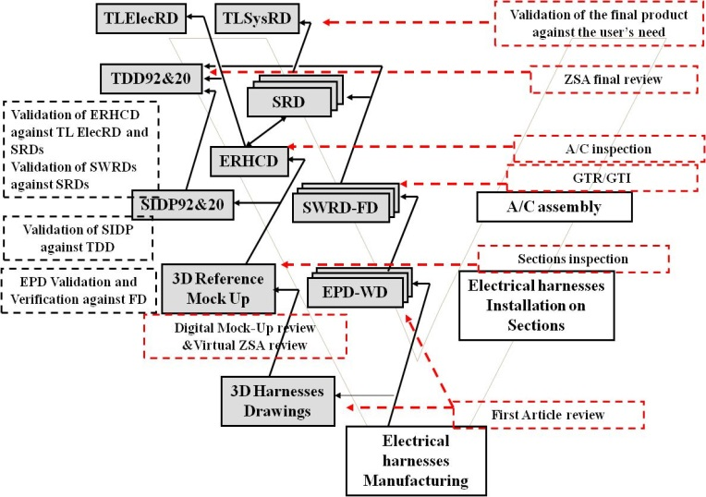
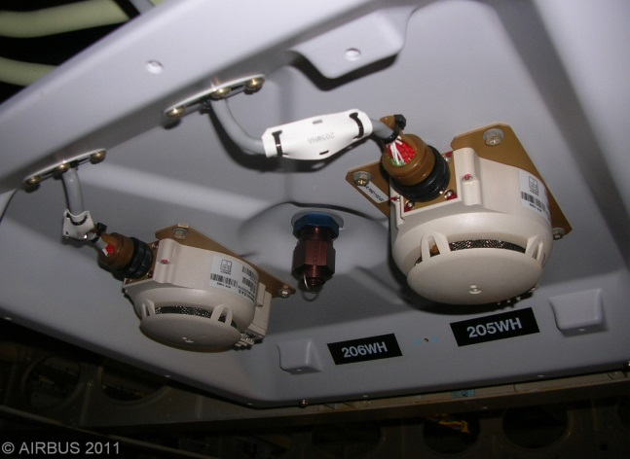
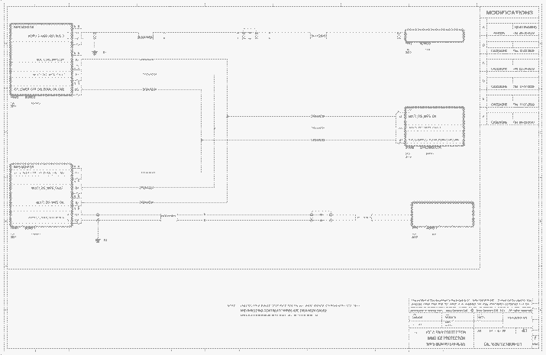
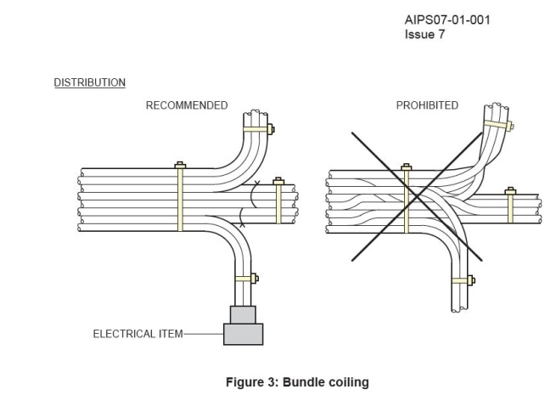
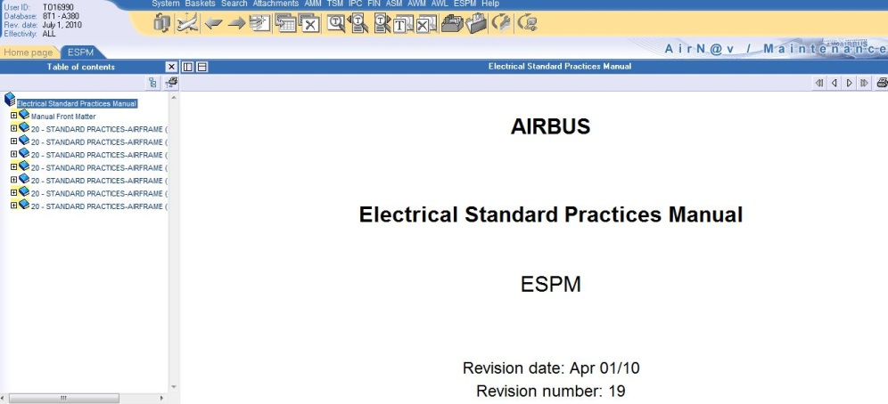
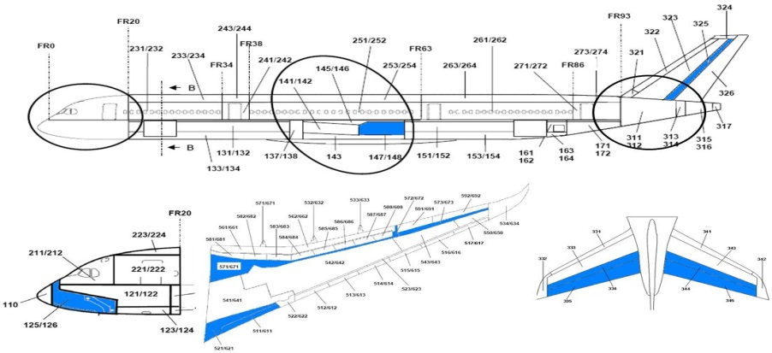
Illustrate traceability between all aspects of A/C wiring
DRAFT
EWIS components design, selection and qualification
Safety analyses
EWIS architecture - routes definition & segregation
EWIS definition process, V&V
EWIS installation design principles and requirements
Interfaces
Systems functional design /
Systems equipment design
Manufacturing procedures
EWIS ICA, maintenance instructions
Environmental conditions, A/C zoning
Etc…

Slide 4
DRAFT
Back-up slides

Slide 5
Représentation des données
DRAFT
Object Property
RUID
Rule
Component
RuleID
Rule primary object
Variant
SubClasses
coupling
equipment
others
Data Properties
Classes

